Slide 1
Predictions of COVID-19 new cases worldwide
An early-stage vaccination evaluation
Machine learning
Lorenz’s Final Project
Data Analytics at Ironhack

Slide 2
Business Question & Workflow
DATA
EDA
ML
Is it possible to use ML to predict future impact? What is the role of vaccination at this stage?
Data Collection & Cleaning
Pairplot
Correlation Matrix
K-Best
All countries in the world
Daily data(Jan 2020 – mid Feb 2021)
17 features
Exploratory Data Analysis
Infections
Social factors
Google mobility
Weather
Extrapolate relevant insights
Evaluate possible targets for data engineering
Building the model
ARIMAX
AR = AutoRegressive
I = Integrated
MA= Moving Average
X = eXogenous
Studying the model theory
Building MVP
Automate the process (185 countries)
Validation of Results

Slide 3

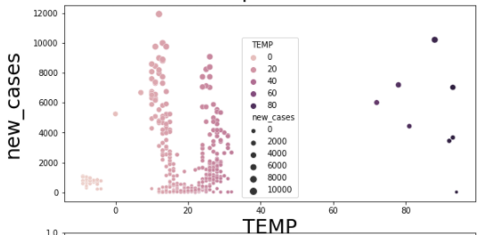
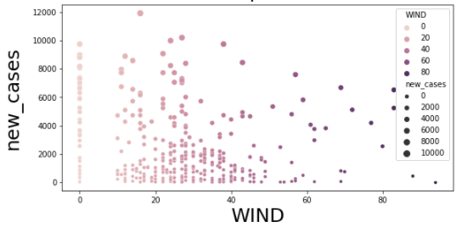
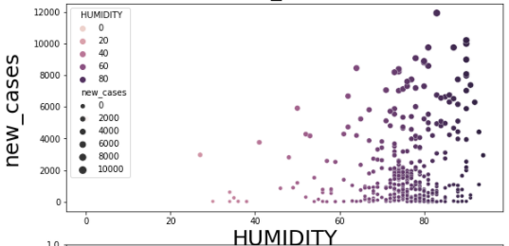
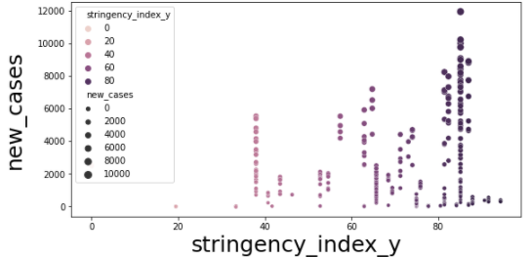
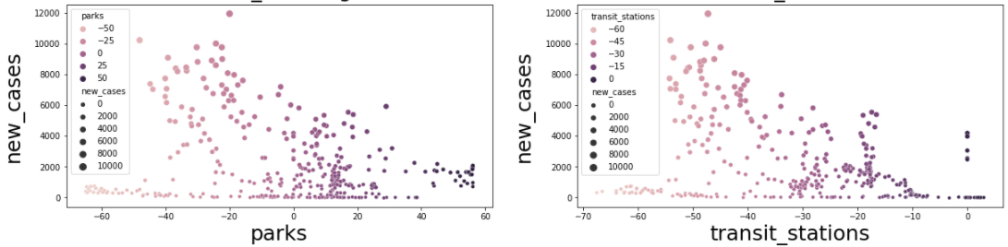
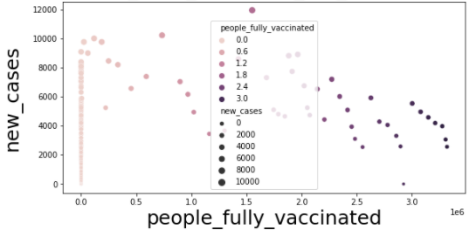
EDA – Interesting Findings
Weather
Adopted
Measures
Vaccination

Slide 4
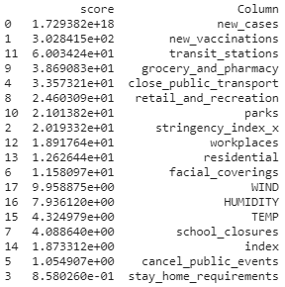
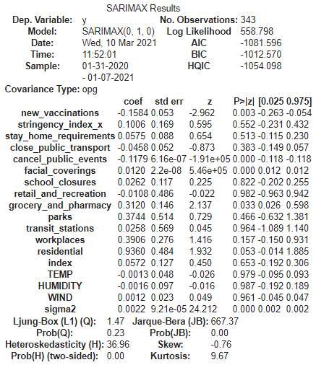
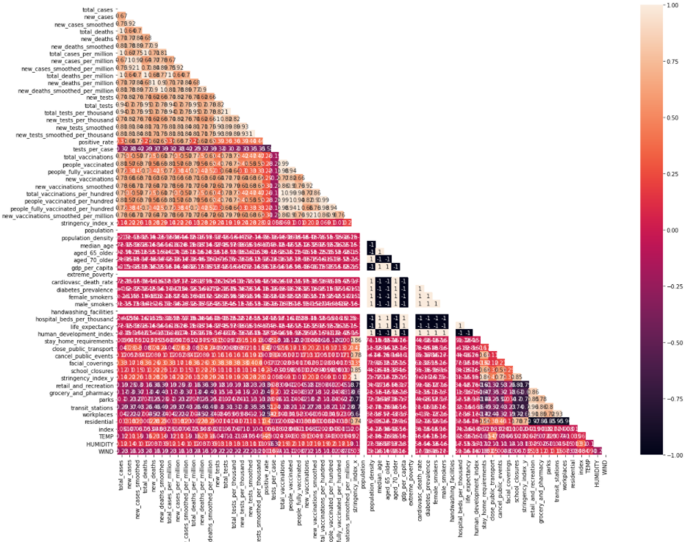
Vaccination as Predictor
Model Stats Summary
K-Best
1
3
Correlation Matrix
2
High correlation with Target: 0.75

Slide 5
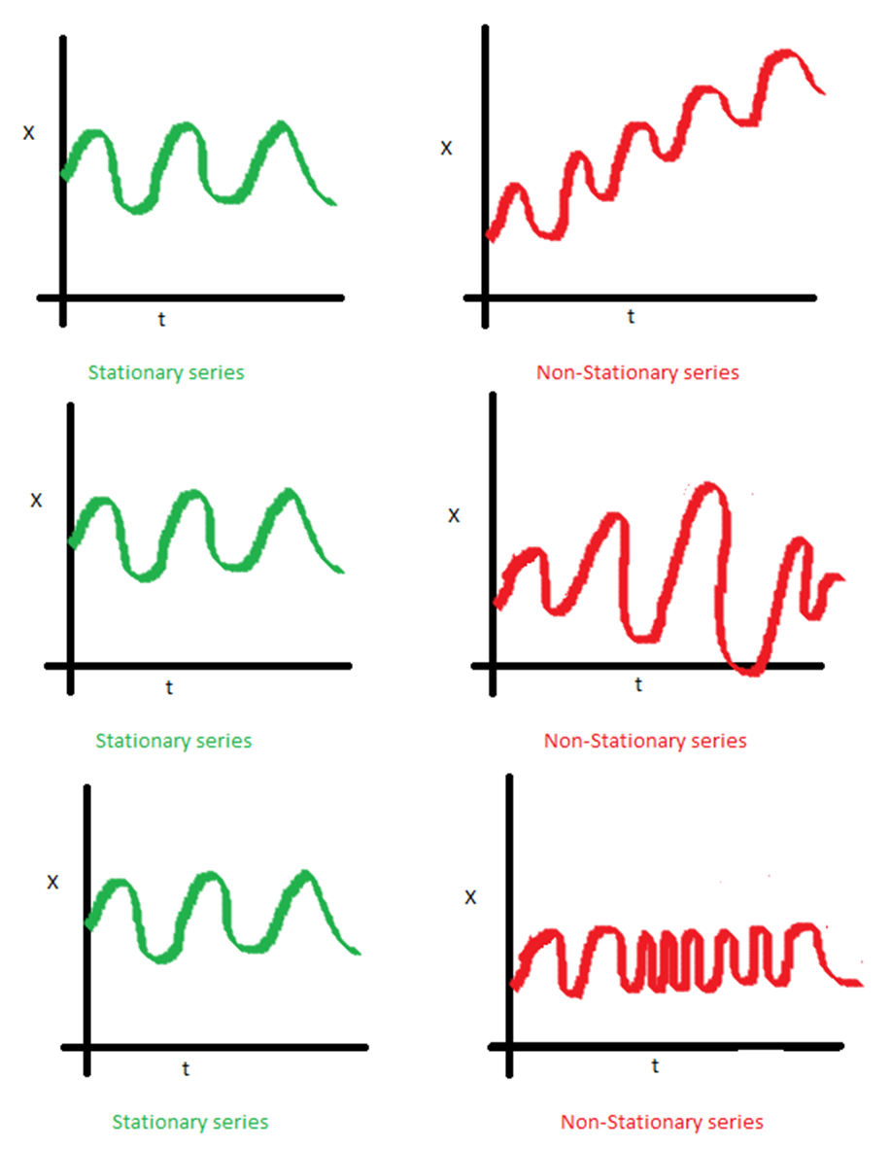

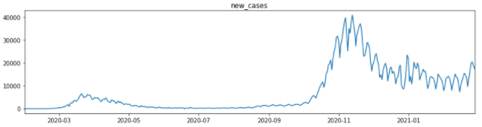
Modeling
AR
I
MA
X
Exogenous features (Xs)
Train Y
Test Y
Prediction

Slide 6
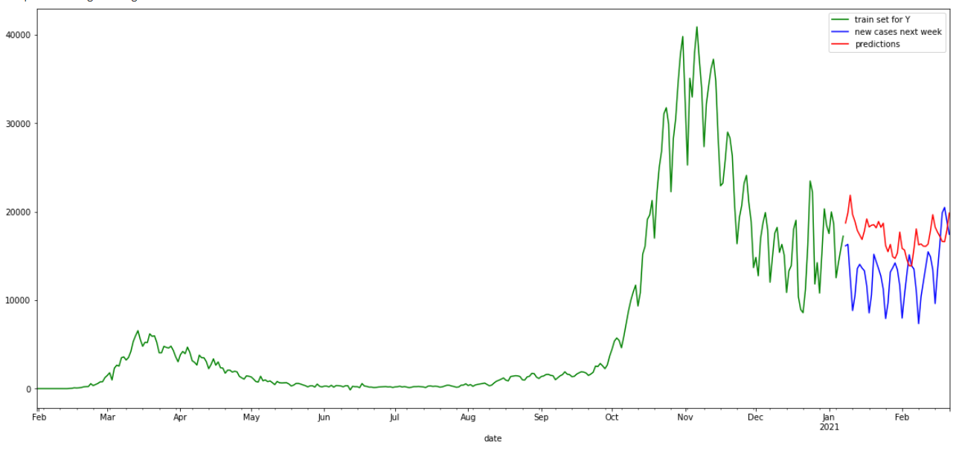
Test Case - Italy
Train Y
Test Y Predictions
New Cases Covid -19
Date

Slide 7
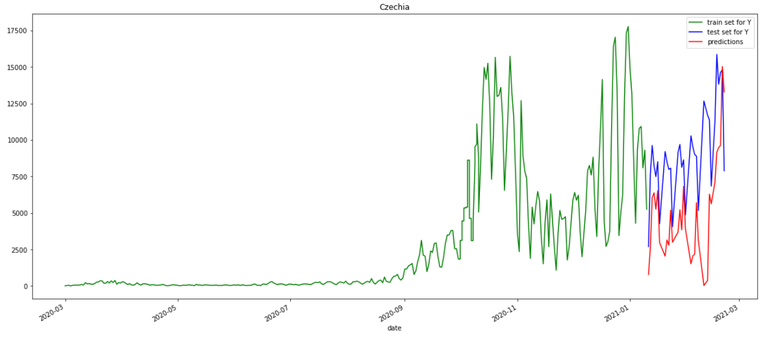
Test Case - Czechia
Train Y
Test Y Predictions
New Cases Covid -19
Date

Slide 8
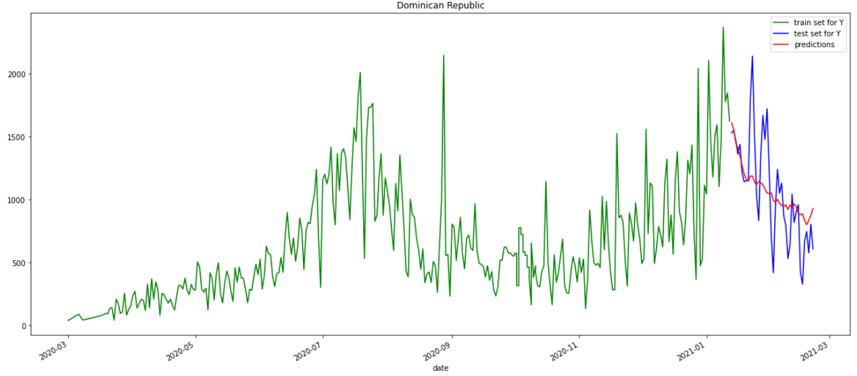
Test Case – Dominican Republic
Train Y
Test Y Predictions
New Cases Covid -19
Date

Slide 9
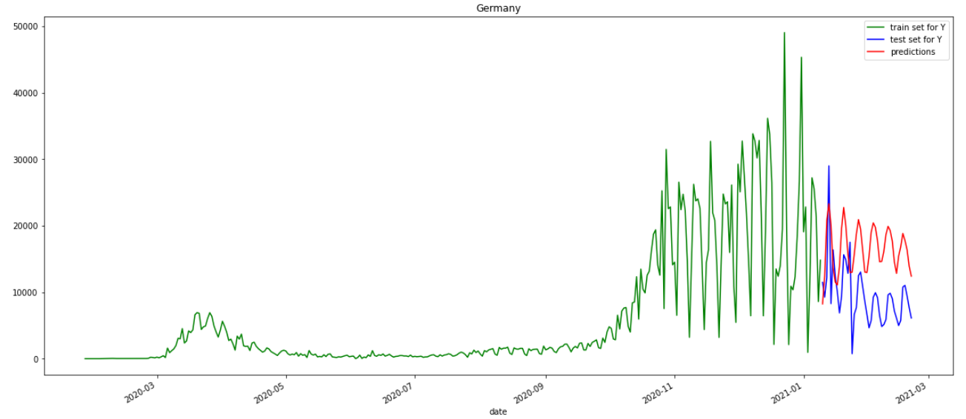
Test Case - Germany
Train Y
Test Y Predictions
New Cases Covid -19
Date

Slide 10
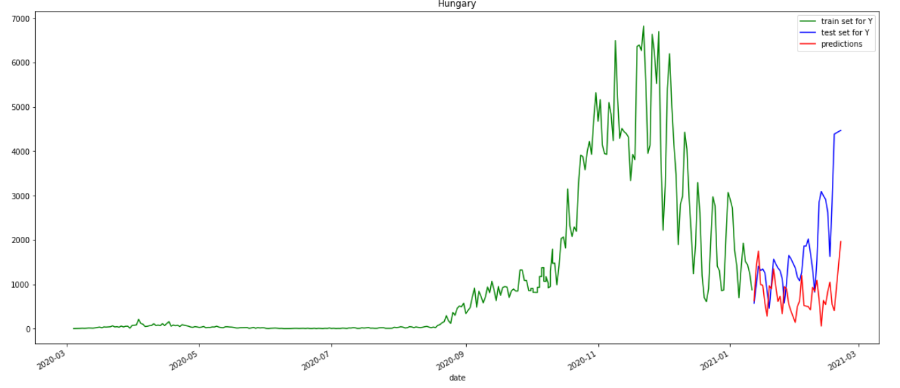
Test Case - Hungary
Train Y
Test Y Predictions
New Cases Covid -19
Date

Slide 11
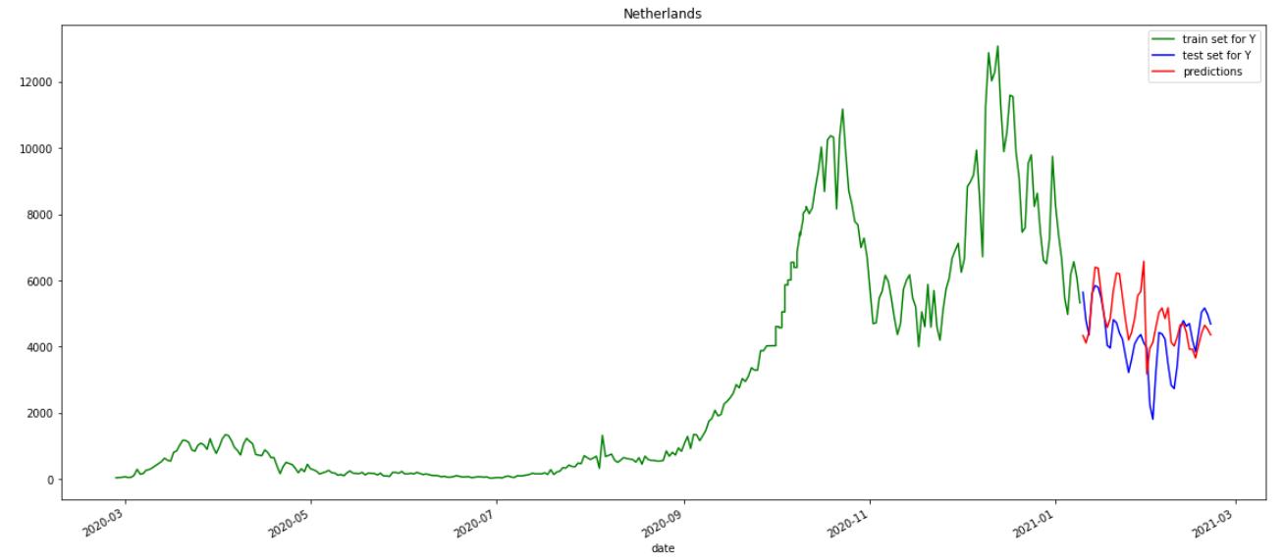
Test Case – the Netherlands
Train Y
Test Y Predictions
New Cases Covid -19
Date

Slide 12
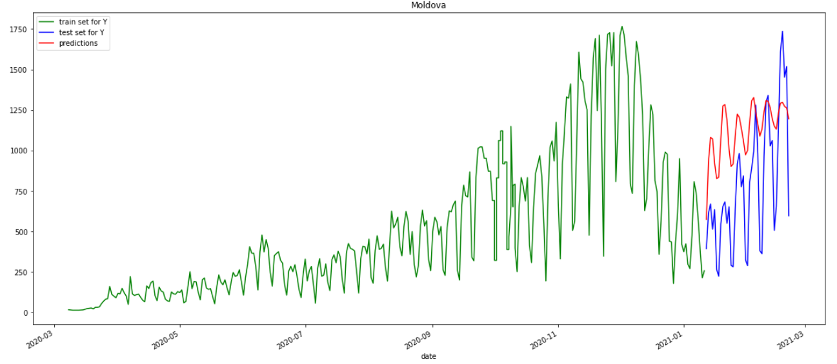
Test Case – Moldova
Train Y
Test Y Predictions
New Cases Covid -19
Date

Slide 13
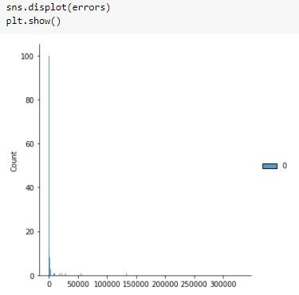
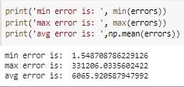
Validation

Slide 14
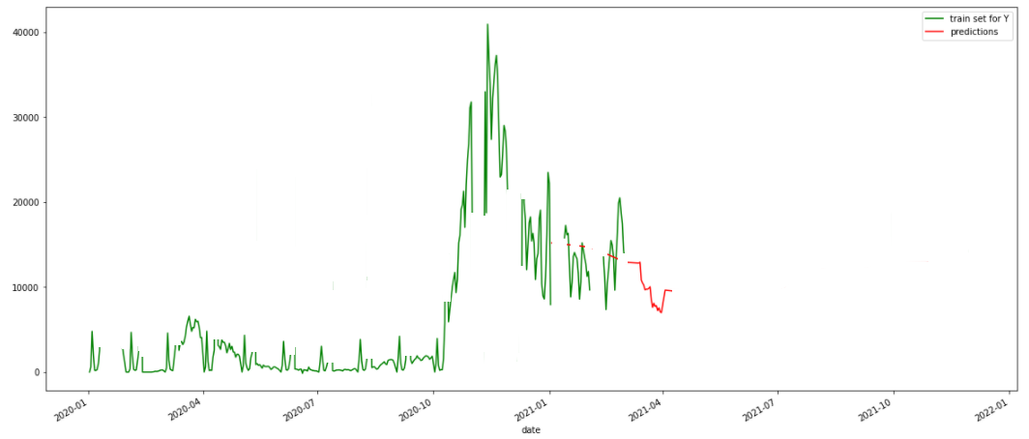
Predicting actual Future
Giving the whole Y as Train set
Predicting using future data from my Xs:
Weather forecast
Vaccination rate at least constant
Inferred stringency in adopted measures
New Cases Covid -19
Date

Slide 15
CONCLUSIONS
01
02
03
ML can indeed help in understanding what the future holds regarding covid spread and Vaccination seems to be a very good predictor
Build a more comprehensive model that takes into account inter-cultural factors
Automate the dataset update so that predictions get updated daily, too
Seasonal component not accounted for. 2 years of data would make the predictions even better (hopefully not!)

Slide 16
Thank you for the Attention!

